Slide 1
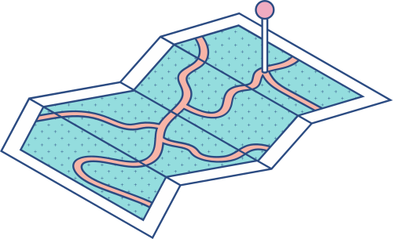
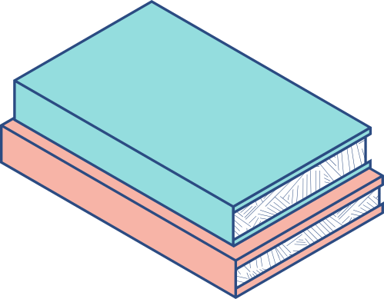




Comparative Analysis of Graph Algorithms on Various Case Studies

Slide 2
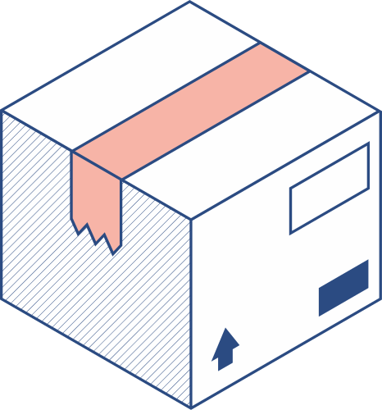
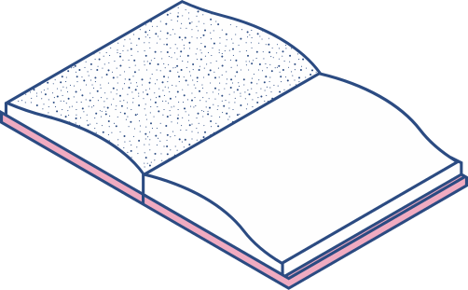



Our Team
Arpit Nayak Ashutosh Wani Rajput Ajay Viraj Surana Bhabad Ganesh
22bds006
22bds008
22bds049
22bds064
22bds067

Slide 3
Facebook Large Page-Page Network
This webgraph is a page-page graph of verified Facebook sites. Nodes represent official Facebook pages while the links are mutual likes between sites
Nodes | 22,470
Edges | 171,002
Density | 0.001
Transitvity | 0.232
Transitivity is the overall probability for the network to have adjacent nodes interconnected, thus revealing the existence of tightly connected communities (or clusters, subgroups, cliques)
Density of a network is determined by its ratio of links to nodes. The higher the ratio, the denser the network

Slide 4
Dynamic Face-to-Face Interaction Networks
The dynamic face-to-face interaction networks represent the interactions that happen during discussions between a group of participants playing the Resistance game
Nodes | 451
Edges | 3,126,993
Number of networks | 62
Total temporal length | 0.232
This dataset contains networks extracted from 62 games. Each game is played by 5-8 participants and lasts between 45-60 minute
The networks are weighted, directed and temporal. Each node represents a participant. At each 1/3 second, a directed edge from node u to v is weighted by the probability of participant u looking at participant v or the laptop

Slide 5
LastFM Asia Social Network
Nodes | 7,624
Edges | 27,806
Density | 0.001
Transitvity | 0.179
Nodes are LastFM users from Asian countries and edges are mutual follower relationships between them. The vertex features are extracted based on the artists liked by the users. The task related to the graph is multinomial node classification - one has to predict the location of users. This target feature was derived from the country field for each user.

Slide 6
Wikipedia Article Networks
These datasets represent page-page networks on specific topic chameleons. Nodes represent articles and edges are mutual links between them. The edges csv files contain the edges - nodes are indexed from 0.
Nodes | 2,277
Edges | 31,421
Density | 0.012
Transitvity | 0.314
The target csv contains the node identifiers and the average monthly traffic between October 2017 and November 2018 for each page. For each page-page network we listed the number of nodes an edges with some other descriptive statistics.

Slide 7
MST (Minimum Spanning Tree)
Shortest Path
Connects all vertices with the minimum total edge weight.
Forms a tree without cycles, including all vertices.
Algorithms like Kruskal's or Prim's algorithm are used.
Used in network design, clustering, and optimization.
Finds the path with the minimum sum of edge weights.
Used to find efficient routes or least costly ways.
Algorithms like Dijkstra's or Bellman-Ford algorithm are used.
Handles weighted/unweighted, directed/undirected graphs.

Slide 8
Algorithms to be explained
Prim's Algorithm
Kruskal's Algorithm
Dijkstra’s Algorithm
Bellman–Ford's Algorithm

Slide 9
Prim's Algorithm
5
3
Prim's Algorithm finds the minimum spanning tree (MST) of a weighted undirected graph. It starts with an arbitrary vertex, repeatedly adds the minimum weight edge connecting a visited vertex to an unvisited vertex, and stops when all vertices are included in the MST
2
2
6
4
5
4
2
2
1
2
Let us take this graph to find shortest path using minimum spanning tree

Slide 10
Considering "3" as a parent node
5
3
5
3
5
3
2
2
2
2
2
2
6
4
6
4
6
4
5
5
5
4
2
4
2
2
4
2
2
2
1
2
1
2
1
2
5
3
5
3
5
3
2
2
2
2
2
2
6
4
6
4
6
4
5
5
5
2
4
2
4
2
4
2
2
2
1
2
1
2
1
2

Slide 11
Kruskal's Algorithm
5
3
In Kruskal’s Algorithm, sort all edges of the given graph in increasing order. Then it keeps on adding new edges and nodes in the MST if the newly added edge does not form a cycle. It picks the minimum weighted edge at first at the maximum weighted edge at last. Thus we can say that it makes a locally optimal choice in each step in order to find the optimal solution. Hence this is a Greedy Algorithm.
2
2
6
4
5
4
2
2
1
2
Let us take this graph to find shortest path using minimum spanning tree

Slide 12
Considering "3" as a parent node
5
3
5
3
5
3
2
2
2
2
2
2
6
4
6
4
6
4
5
5
5
2
4
2
2
4
2
2
4
2
1
2
1
2
1
2
5
3
5
3
5
3
2
2
2
2
2
2
6
4
6
4
6
4
5
5
5
2
4
2
4
2
4
2
2
2
1
2
1
2
1
2

Slide 13
Dijkstra’s Algorithm
7
2
1
Dijkstra's Algorithm to finds the shortest path between nodes it calculates the distance through it to each unvisited neighbor, and updates the neighbor's distance if it is smaller then it marks as visited when it is done with neighbors.
1
2
4
5
3
Let us take this graph to find shortest path

Slide 14
7
2
7
∞
2
7
∞
2
1
2
1
2
1
1
2
3
∞
∞
1
2
1
2
1
2
4
5
4
4
∞
5
4
3
∞
5
3
3
3
2
7
9
2
7
9
2
7
8
2
1
2
1
2
1
4
5
6
∞
∞
∞
1
2
1
2
1
2
4
3
∞
5
4
3
6
5
4
3
6
5
3
3
3
2
7
8
2
1
7
11
1
2
4
3
6
5
3

Slide 15
Bellman–Ford's Algorithm
The Bellman–Ford Algorithm is an algorithm that computes shortest paths from a single source vertex to all of the other vertices in a weighted digraph. It is slower than Dijkstra's algorithm for the same problem, but more versatile, as it is capable of handling graphs in which some of the edge weights are negative numbers.
1
6
-2
3
4
3
-2
5
1
Let us take this graph to find shortest path

Slide 16
∞
∞
6
∞
6
∞
B
-1
E
B
-1
E
B
-1
E
0
6
0
6
6
-2
3
-2
3
0
-2
3
A
C
∞
A
C
A
C
4
3
4
∞
3
4
4
3
-2
-2
-2
5
D
F
5
D
F
5
D
F
∞
-1
∞
∞
-1
∞
∞
-1
∞
6
5
6
5
6
∞
B
-1
E
B
-1
0
6
E
B
-1
E
-2
3
0
6
6
-2
3
0
-2
3
A
4
C
A
3
3
4
C
3
A
4
C
4
4
3
-2
-2
-2
5
D
F
F
5
D
F
5
D
F
5
-1
∞
-1
∞
-1
∞
5
5

Slide 17
6
5
1
5
1
0
B
-1
E
B
-1
E
B
-1
E
0
6
6
-2
3
0
-2
0
6
3
-2
3
0
A
4
C
A
C
A
C
3
4
3
3
4
3
3
3
-2
-2
-2
5
D
F
5
D
F
5
D
F
-1
4
5
-1
-1
5
4
5
4
1
0
edges :- (A,B),(A,C),(A,D),(B,E),(C,E),(D,C),(D,F),(E,F),(C,F)
B
-1
E
0
6
-2
3
A
C
4
3
3
-2
5
D
F
-1
5
3

Slide 18
Results Of Datasets
 | Mean | Median | Min | Max
Prims Algorithm | 72897.25 | 15046 | 60 | 261437
kruskal Algorithm | 72897.25 | 15046 | 60 | 261437
Dijkstra’s Algorithm | 3.75 | 3.5 | 2 | 6
Bellman–Ford algorithm | 3.75 | 3.5 | 2 | 6

Slide 19
Results Of Mid - Sem Q5
 | Mean | Median | Mod | Max
Prims Algorithm | 10.666667 | 10 | 10 | 12
kruskal Algorithm | 10.666667 | 10 | 10 | 12
Dijkstra’s Algorithm | 7.333334 | 6 | 6 | 10
Bellman–Ford algorithm | 7.333334 | 6 | 6 | 10

Slide 20
THANK
YOU
Git-Hub link --
CLICK HERE

